Slide 1
Project Student Database Management
AKM ASHIQUZZAMAN
13101002
SABBIR AHMED
13101012
TASNIA AFROZ
13101026

Slide 2
Slide Contents
Introduction
Features
Applications
Equipments
Flow Charts
Info/Acknowledgements
Future Work/Motivations
Conclusion

Slide 3
Features
User Friendly Console Based Interface.
20 Attributes of a Student covering Almost every useful Academic information in the Structure.
Info handling Functions Like Showing and Loading Data from data file.
Adding New Data.
Editing Existing Data.
Rich Attribute Based Searching Like-
Name Based
Age Based
Cgpa Based

Slide 4
Applications
In almost every Educational Institutions, specially Universities and Colleges.(This program has been modified for Particular institutions )
Coaching or Mentoring facilities.
Personal using.(i.e: Parents for their children, teachers for their students)

Slide 5
Equipments
GNU GCC Compiler(MinGW)
CodeBlocks IDE
Notepad++
Special Header Files
Windows.h
(for accessing some windows based DOS functions, like system, cmd, etc. )

Slide 6
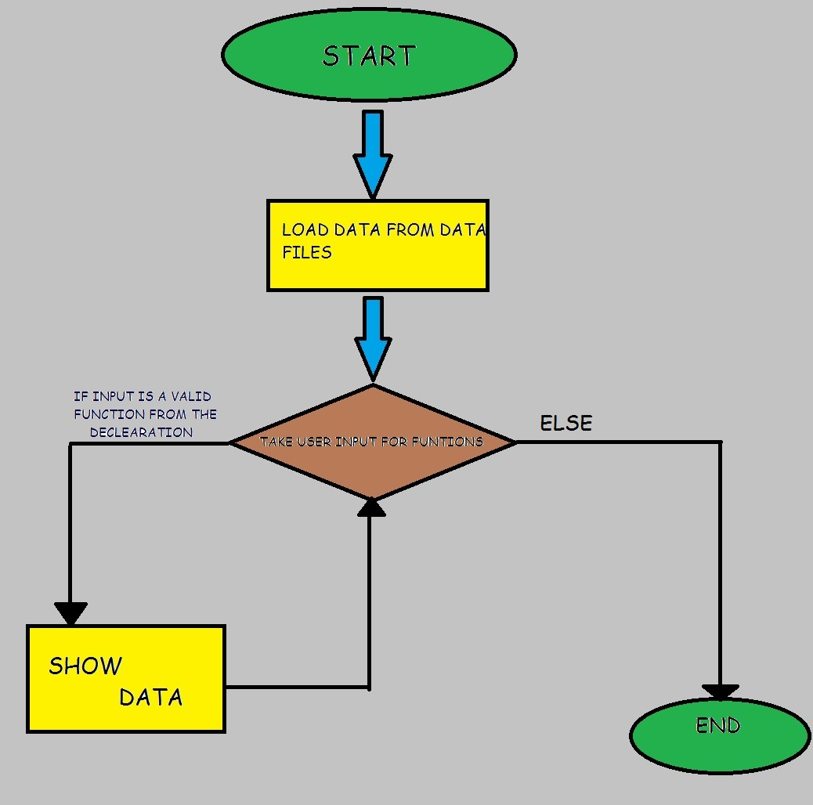
Flow Chart
THIS IS A SIMPLIFED FLOW CHART

Slide 7
Acknowledgements
Stackoverflow.com
Cplusplus.com

Slide 8
Future Work Or Motivations
Converting this project from C to Java
Android Apps.
Improved PHP and MySQL version
Adding Network Based Database
Using the .NET Framework

Slide 9
Thanks to all

